Slide 1

Unit-4 Pipelining and Computer Arithmetic
Computer System Architecture(CSA)
DU # 2101CS602
Prof. Vishal Kansagara
Computer Engineering Department
Vishal.kansagara@darshan.ac.in
8200601076

Slide 2

Outline
Flynn's taxonomy
Parallel Processing
Pipelining
Arithmetic Pipeline
Instruction Pipeline
RISC Pipeline
Addition and Subtraction
Multiplication Algorithms (Booth Multiplication Algorithm)
Looping

Slide 3
Flynn's taxonomy
Section - 1

Slide 4
Flynn's taxonomy
Data Stream
Single
Multiple
Instruction Stream
Single
SISD
SIMD
Multiple
MISD
MIMD

Slide 5
Single Instruction Single Data & Single Instruction Multiple Data
Single Instruction Single Data (SISD)
SISD represents the organization of a single computer containing a control unit, a processor unit, and a memory unit.
Instructions are executed sequentially and the system may or may not have internal parallel processing capabilities.
Single Instruction Multiple Data (SIMD)
SIMD represents an organization that includes many processing units under the supervision of a common control unit.
All processors receive the same instruction from the control unit but operate on different items of data.

Slide 6
Multiple Instruction Single Data & Multiple Instruction Multiple Data
Multiple Instruction Single Data (MISD)
There is no computer at present that can be classified as MISD.
MISD structure is only of theoretical interest since no practical system has been constructed using this organization.
Multiple Instruction Multiple Data (MIMD)
MIMD organization refers to a computer system capable of processing several programs at the same time.
Most multiprocessor and multicomputer systems can be classified in this category.
Contains multiple processing units.
Execution of multiple instructions on multiple data.

Slide 7
Parallel Processing
Section - 2

Slide 8
Parallel Processing
Parallel processing is a term used to denote a large class of techniques that are used to provide simultaneous data-processing tasks for the purpose of increasing the computational speed of a computer system.
Purpose of parallel processing is to speed up the computer processing capability and increase its throughput.
Throughput:
The amount of processing that can be accomplished during a given interval of time.

Slide 9
Pipelining
Section - 3

Slide 10
Pipelining
Pipeline is a technique of decomposing a sequential process into sub operations, with each sub process being executed in a special dedicated segment that operates concurrently with all other segments.
A pipeline can be visualized as a collection of processing segments through which binary information flows.
Each segment performs partial processing dictated by the way the task is partitioned.
The result obtained from the computation in each segment is transferred to the next segment in the pipeline.
The registers provide isolation between each segment.
The technique is efficient for those applications that need to repeat the same task many times with different sets of data.

Slide 11
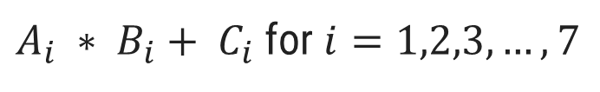
Pipelining example
$A_{i} ∗ B_{i}+ C_{i}$ for $i=1,2,3,…,7$
R1
R2
Multiplier
R3
R4
Adder
R5

Slide 12
Pipelining
General structure of four segment pipeline
Clock
S₁
R₁
S₂
R₂
S₃
R₃
S₄
R₄
Input

Slide 13
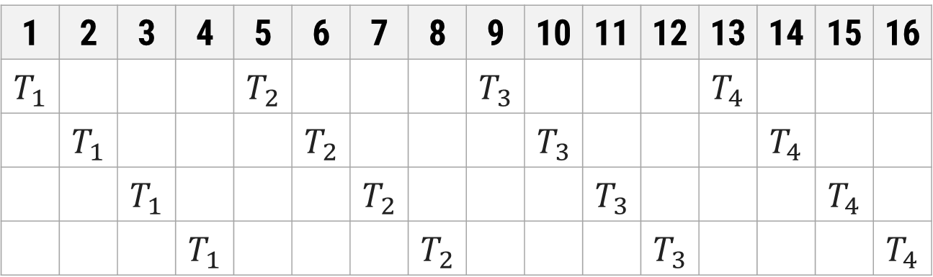
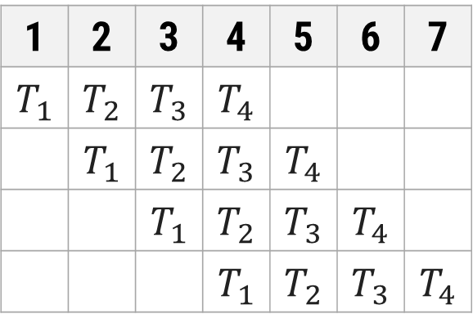
Space-time Diagram
Segment
1 | 2 | 3 | 4 | 5 | 6 | 7 | 8 | 9 | 10 | 11 | 12 | 13 | 14 | 15 | 16
$$T_{1}$$ |  |  |  | $$T_{2}$$ |  |  |  | $$T_{3}$$ |  |  |  | $$T_{4}$$
 | $$T_{1}$$ |  |  |  | $$T_{2}$$ |  |  |  | $$T_{3}$$ |  |  |  | $$T_{4}$$
 |  | $$T_{1}$$ |  |  |  | $$T_{2}$$ |  |  |  | $$T_{3}$$ |  |  |  | $$T_{4}$$
 |  |  | $$T_{1}$$ |  |  |  | $$T_{2}$$ |  |  |  | $$T_{3}$$ |  |  |  | $$T_{4}$$
1
2
Non Pipelined Architecture
3
4
Segment
1 | 2 | 3 | 4 | 5 | 6 | 7
$$T_{1}$$ | $$T_{2}$$ | $$T_{3}$$ | $$T_{4}$$
 | $$T_{1}$$ | $$T_{2}$$ | $$T_{3}$$ | $$T_{4}$$
 |  | $$T_{1}$$ | $$T_{2}$$ | $$T_{3}$$ | $$T_{4}$$
 |  |  | $$T_{1}$$ | $$T_{2}$$ | $$T_{3}$$ | $$T_{4}$$
Clock cycles
1
2
Pipelined Architecture
3
4

Slide 14
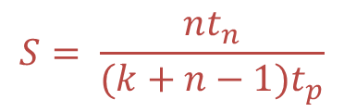
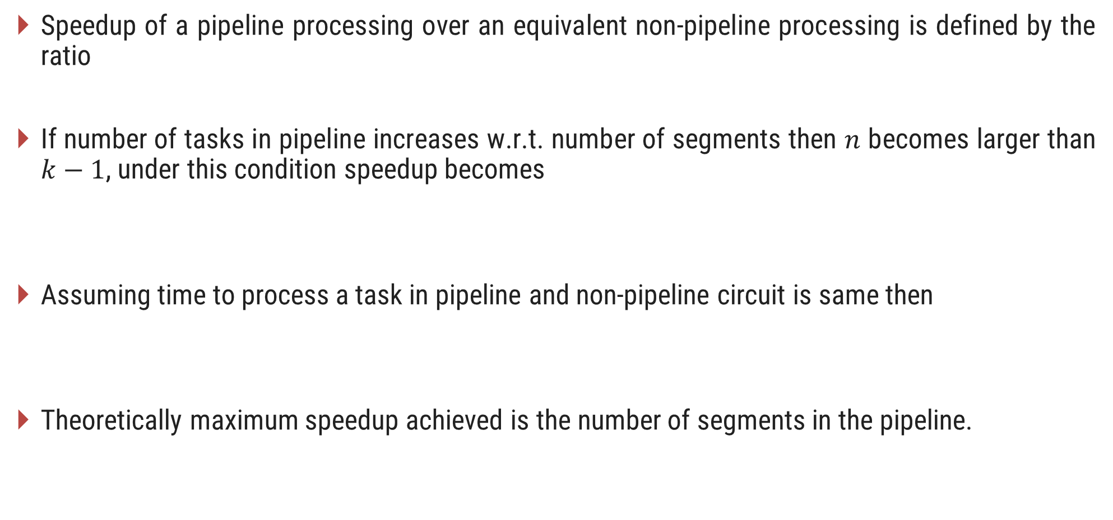
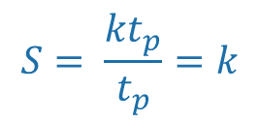

Speedup
Speedup of a pipeline processing over an equivalent non-pipeline processing is defined by the ratio
If number of tasks in pipeline increases w.r.t. number of segments then $n$ becomes larger than $k−1$, under this condition speedup becomes
Assuming time to process a task in pipeline and non-pipeline circuit is same then
Theoretically maximum speedup achieved is the number of segments in the pipeline.
$$S= \frac{nt_{n}}{(k+n−1)t_{p}}$$
$$S=\frac{{nt}_{n}}{{nt}_{p}}=\frac{t_{n}}{t_{p}}$$
$$S= \frac{{kt}_{p}}{t_{p}}=k$$

Slide 15
Arithmetic Pipeline
Section - 4

Slide 16
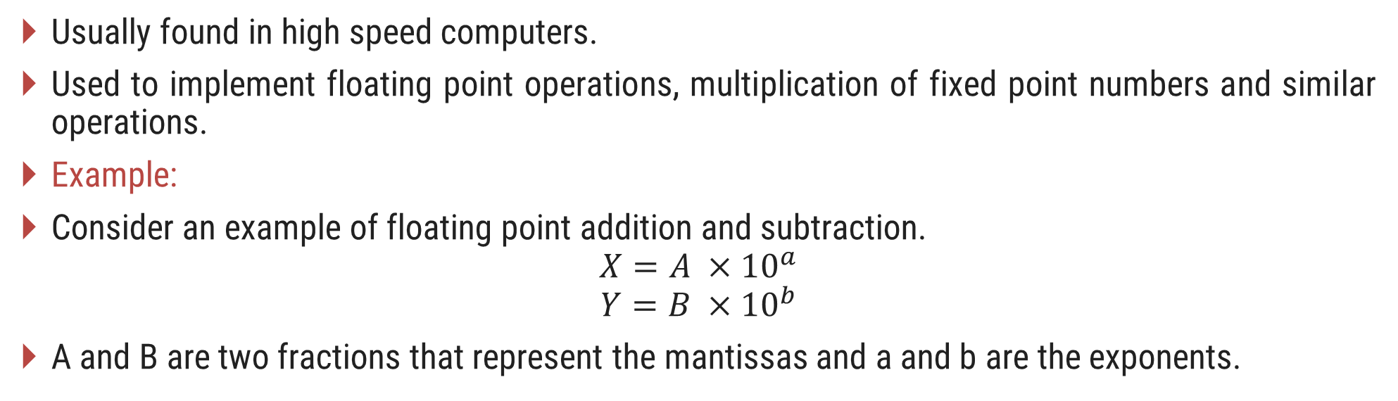
Arithmetic Pipeline
Usually found in high speed computers.
Used to implement floating point operations, multiplication of fixed point numbers and similar operations.
Example:
Consider an example of floating point addition and subtraction.
$$X=A ×{10}^{a}$$
$$Y=B ×{10}^{b}$$
A and B are two fractions that represent the mantissas and a and b are the exponents.

Slide 17
Example of Arithmetic Pipeline
Consider the two normalized floating-point numbers:
X = 0.9504 x 10³ Y = 0.8200 x 10²
Segment-1: The larger exponent is chosen as the exponent of result.
Segment-2: Aligning the mantissa numbers
X = 0.9504 x 10³ Y = 0.0820 x 10³
Segment-3: Addition of the two mantissas produces the sum
Z = 1.0324 x 10³
Segment-4: Normalize the result
Z = 0.10324 x 10⁴
The sub-operations that are performed in the four segments are:
Compare the exponents
Align the mantissas
Add or subtract the mantissas
Normalize the result

Slide 18
A
Mantissas
a
Exponents
B
b
R
R
Segment 1:
Compare exponents by subtraction
Difference
R
Segment 2:
Choose exponent
Align mantissas
R
Segment 3:
Add or subtract mantissas
R
R
Segment 4:
Adjust exponent
Normalize result
R
R

Slide 19
Instruction Pipeline
Section - 5

Slide 20
Instruction Pipeline
In the most general case, the computer needs to process each instruction with the following sequence of steps
Fetch the instruction from memory.
Decode the instruction.
Calculate the effective address.
Fetch the operands from memory.
Execute the instruction.
Store the result in the proper place.
Different segments may take different times to operate on the incoming information.
Some segments are skipped for certain operations.
The design of an instruction pipeline will be most efficient if the instruction cycle is divided into segments of equal duration.

Slide 21
Instruction Pipeline
Assume that the decoding of the instruction can be combined with the calculation of the effective address into one segment.
Assume further that most of the instructions place the result into a processor registers so that the instruction execution and storing of the result can be combined into one segment.
This reduces the instruction pipeline into four segments.
FI: Fetch an instruction from memory
DA: Decode the instruction and calculate the effective address of the operand
FO: Fetch the operand
EX: Execute the operation

Slide 22
Four segment CPU pipeline
Fetch instruction from memory
Segment1:
Segment2:
Decode instruction & calculate effective address
yes
Branch?
no
Segment3:
Fetch operand from memory
Segment4:
Execute instruction
Interrupt handling
yes
Interrupt?
no
Update PC
Empty pipe

Slide 23
Space-time Diagram
Step:
1 | 2 | 3 | 4 | 5 | 6 | 7 | 8 | 9 | 10 | 11 | 12 | 13
FI | DA | FO | EX
 | FI | DA | FO | EX
 |  | FI | DA | FO | EX
 |  |  | FI | DA | FO | EX
 |  |  |  | FI | DA | FO | EX
 |  |  |  |  | FI | DA | FO | EX
 |  |  |  |  |  | FI | DA | FO | EX
Instruction 1
2
3
4
5
6
7

Slide 24
Space-time Diagram
Step:
1 | 2 | 3 | 4 | 5 | 6 | 7 | 8 | 9 | 10 | 11 | 12 | 13
FI | DA | FO | EX
 | FI | DA | FO | EX
 |  | FI | DA | FO | EX
 |  |  | FI | - | - | FI | DA | FO | EX
 |  |  |  | - | - | - | FI | DA | FO | EX
 |  |  |  |  |  |  |  | FI | DA | FO | EX
 |  |  |  |  |  |  |  |  | FI | DA | FO | EX
Instruction 1
2
(Branch)
3
4
5
6
7

Slide 25
Pipeline Conflict & Data Dependency
Pipeline Conflict
There are three major difficulties that cause the instruction pipeline conflicts.
Resource conflicts caused by access to memory by two segments at the same time. Most of these conflicts can be resolved by using separate instruction and data memories.
Data dependency conflicts arise when an instruction depends on the result of a previous instruction, but this result is not yet available.
Branch difficulties arise from branch and other instructions that change the value of PC.
Data Dependency
Data dependency occurs when an instruction needs data that are not yet available.
Pipelined computers deal with such conflicts between data dependencies in a variety of ways as follows:
Hardware Interlocks
Operand forwarding
Delayed load

Slide 26
Handling Branch Instructions
The branch instruction breaks the normal sequence of the instruction stream, causing difficulties in the operation of the instruction pipeline.
Hardware techniques available to minimize the performance degradation caused by instruction branching are as follows:
Pre-fetch target
Branch target buffer
Loop buffer
Branch prediction
Delayed branch

Slide 27
RISC Pipeline
Section - 6

Slide 28
RISC Pipeline (Three segment instruction pipeline)
Because of the fixed-length instruction format, the decoding of the operation can occur at the same time as the register selection.
Since all the operands are in registers, there is no need for calculating an effective address or fetching of operands from memory.
RISC has main two facilities:
Single-cycle instruction execution
Compiler support
Mainly three types of instructions in RISC:
Data manipulation instructions
Data transfer instructions
Program control instructions
The instruction cycle can be divided into three sub-operations and implemented in three segments:
I : Instruction fetch
A : ALU operation
E : Execute instruction

Slide 29
Delayed Load
Clock cycles:
1 | 2 | 3 | 4 | 5 | 6
I | A | E
 | I | A | E
 |  | I | A | E
 |  |  | I | A | E
Load R1
Pipeline timing with data conflict
Load R2
Add R1+R2
Store R3
Clock cycles:
1 | 2 | 3 | 4 | 5 | 6 | 7
I | A | E
 | I | A | E
 |  | I | A | E
 |  |  | I | A | E
 |  |  |  | I | A | E
Load R1
Load R2
No-operation
Pipeline timing with delayed load
Add R1+R2
Store R3

Slide 30
Delayed Branch
Clock cycle:
1 | 2 | 3 | 4 | 5 | 6 | 7 | 8 | 9 | 10
I | A | E
 | I | A | E
 |  | I | A | E
 |  |  | I | A | E
 |  |  |  | I | A | E
 |  |  |  |  | I | A | E
 |  |  |  |  |  | I | A | E
 |  |  |  |  |  |  | I | A | E
Load R1
Increment R2
Add R3+R4
Subtract R6-R5
Branch to X
No operation
No operation
Instruction in X
Using no-operation instructions

Slide 31
Delayed Branch
Clock cycle:
1 | 2 | 3 | 4 | 5 | 6 | 7 | 8
I | A | E
 | I | A | E
 |  | I | A | E
 |  |  | I | A | E
 |  |  |  | I | A | E
 |  |  |  |  | I | A | E
Load R1
Increment R2
Branch to X
Add R3+R4
Subtract R6-R5
Instruction in X
Rearranging the instructions

Slide 32
Addition and Subtraction
Section - 1

Slide 33
Addition and Subtraction
Operation | Add Magnitudes | Subtract Magnitudes
 |  | When A > B | When A < B | When A = B
(+A) + (+B) | + (A + B)
(+A) + (-B) |  | + (A - B) | - (B - A) | + (A - B)
(-A) + (+B) |  | - (A - B) | + (B - A) | + (A - B)
(-A) + (-B) | - (A + B)
(+A) - (+B) |  | + (A - B) | - (B - A) | + (A - B)
(+A) - (-B) | + (A + B)
(-A) - (+B) | - (A + B)
(-A) - (-B) |  | - (A - B) | + (B - A) | + (A - B)

Slide 34
Flowchart for Addition & Subtraction
Subtract operation
Add operation
A_{s} = Sign bit of A
Minuend in A
Subtrahend in B
Augend in A
Addend in B
B_{s} = Sign bit of B
= 0
A_{s}⊕B_{s}
= 1
= 1
A_{s}⊕B_{s}
= 0
A_{s} = B_{s}
A_{s} ≠ B_{s}
A_{s} ≠ B_{s}
A_{s} = B_{s}
EA ← A+B’+1
AVF ← 0
EA ← A+B
= 0
= 1
A < B
E
A ≥ B
AVF ← E
A ← A’
≠ 0
A
= 0
A ← A+1
A_{s} ← A_{s}’
A_{s} ← 0
E = Carry
AVF = add overflow flip-flop
END
(result is in A and A_{s})

Slide 35
Multiplication Algorithms (Booth Multiplication Algorithm)
Section - 2

Slide 36




Multiplication
Traditional way of binary multiplication
Multiply operation
Multiplicand in B Multiplier in Q
23
10111
x
19
x
10011
$$A_{S} ← Q_{S }⊕ B_{S}$$
$$Q_{S} ← Q_{S }⊕ B_{S}$$
$$A←0,E←0$$
$$SC←n−1$$
10111
10111
00000
= 0
$$Q_{n}$$
= 1
00000
10111
$$EA←A+B$$
437
110110101
$$shr EAQ$$
$$SC←SC −1$$
≠ 0
SC
= 0
END
(PRODUCT is in AQ)

Slide 37
Perform 23 x 19
Multiplicand B = 10111 | E | A | Q | SC
Multiplier in Q | 0 | 00000 | 10011 | 101
Q_{n} = 1; add B |  | 10111
First partial product | 0 | 10111
Shift right EAQ | 0 | 01011 | 11001 | 100
Q_{n} = 1; add B |  | 10111
Second partial product | 1 | 00010
Shift right EAQ | 0 | 10001 | 01100 | 011
Q_{n} = 0; shift right EAQ | 0 | 01000 | 10110 | 010
Q_{n} = 0; shift right EAQ | 0 | 00100 | 01011 | 001
Q_{n} = 1; add B |  | 10111
Fifth partial product | 0 | 11011
Shift right EAQ | 0 | 01101 | 10101 | 000
Final product in AQ = 0110110101

Slide 38
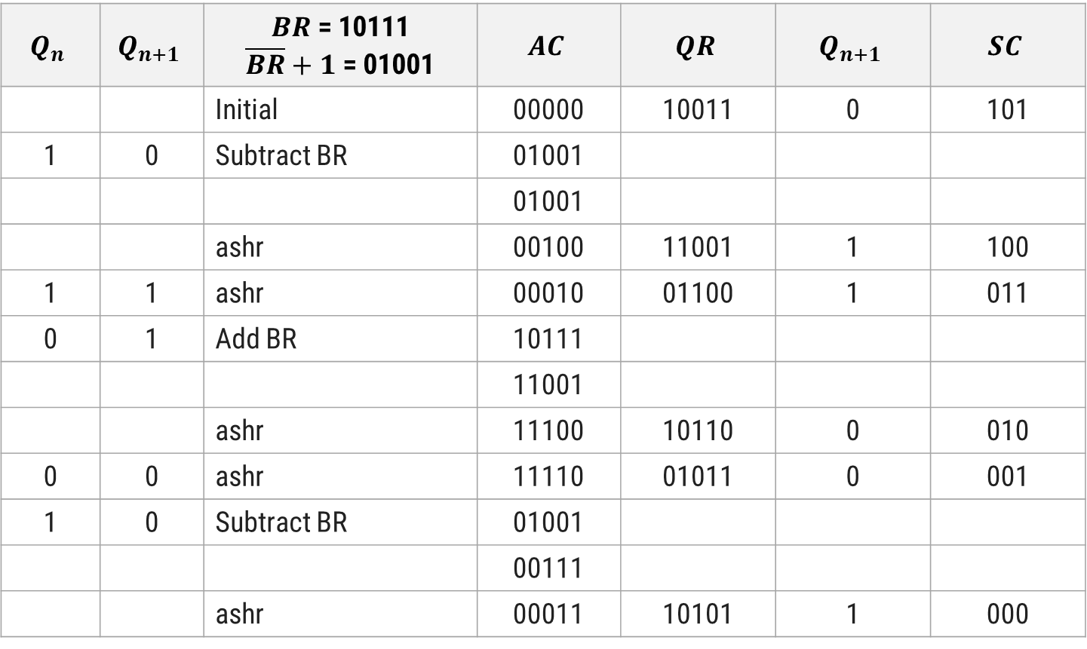
Multiply (-9) x (-13) using Booth Algorithm
$$Q_{n}$$ | $$Q_{n+1}$$ | $BR$ = 10111 $\overline{BR}+1$ = 01001 | $$AC$$ | $$QR$$ | $$Q_{n+1}$$ | $$SC$$
 |  | Initial | 00000 | 10011 | 0 | 101
1 | 0 | Subtract BR | 01001
 |  |  | 01001
 |  | ashr | 00100 | 11001 | 1 | 100
1 | 1 | ashr | 00010 | 01100 | 1 | 011
0 | 1 | Add BR | 10111
 |  |  | 11001
 |  | ashr | 11100 | 10110 | 0 | 010
0 | 0 | ashr | 11110 | 01011 | 0 | 001
1 | 0 | Subtract BR | 01001
 |  |  | 00111
 |  | ashr | 00011 | 10101 | 1 | 000

Slide 39

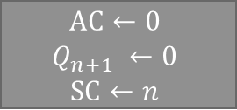

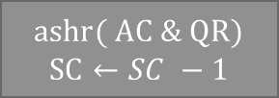

Booth Multiplication Algorithm
Multiply operation
Multiplicand in BR Multiplier in QR
$$AC←0$$
$$Q_{n+1} ←0$$
$$SC←n$$
= 10
$$Q_{n}Q_{n+1}$$
= 01
= 00
= 11
$$AC←AC+\overline{BR}+1$$
$$AC←AC+BR$$
$ashr( AC \& QR)$
$$SC←SC −1$$
≠ 0
SC
= 0
END

Slide 40
Thank you


